Slide 1
Slides for display board

Slide 2
COSA Health and Wellness Evidence Based Program Offerings
For more information regarding COSA’s Health and Wellness program offerings; opportunities to volunteer as program leaders; or to bring programs to your local community or group, contact:
Ellen Williams at 610-499-1937or e-mail williamse@co.delaware.pa.us

Slide 3
Chronic Pain Self-Management
Developed by the Self-Management Resource Center, this small group 6-week program meets once a week for 2 ½ hours. Research shows that people who participated in the program have more vitality or energy, less pain, less dependence on others, improved mental health, are more involved in everyday activities, and are more satisfied with their lives compared to those who have not taken the program.
Subjects Discussed Include:
Techniques to deal with problems such as frustration, fatigue, isolation, and poor sleep
Appropriate exercise for maintaining and improving strength, flexibility, and endurance
Appropriate use of medications
Communicating effectively with family, friends, and health professionals
Nutrition
Pacing activity and rest
How to evaluate new treatments
Participants make weekly action plans, share experiences, and help each other solve problems they encounter in creating and carrying out their self-management program.

Slide 4
Chronic Disease Self-Management About 80% of older adults have at least one chronic disease, and 68% have at least two.
Developed by Stanford University, this small group 6-week program meets once a week for 2 ½ hours. The programs is proven to help older adults better manage their chronic conditions, improve their quality of life, and lower health care costs.
Workshop is designed to help people gain self-confidence in their ability to control their symptoms and learn how their health problems affect their lives. The workshop topics include the following:
How to deal with frustration, fatigue, pain, and isolation.
Ways to maintain and improve strength, flexibility, and endurance.
Managing medications.
How to communicate more effectively with family, friends, and health professionals.
Healthy eating
Participants make weekly action plans, share experiences, and help each other solve problems they encounter in creating and carrying out their self-management program.

Slide 5
Diabetes Self-Management Diabetes is the 6th leading cause of death in Delaware County and in PA for all age groups.
Developed by Stanford University, this small group 6-week program meets once a week for 2 ½ hours. The program provide individuals with the tools to be a good self-manager of their diabetes. The teaching process makes this program effective. Classes are highly participatory. Mutual support and success builds participants’ confidence in their ability to manage their health and maintain active and fulfilling lives.
Subjects Taught Include:
Techniques to deal with the symptoms of diabetes, fatigue, pain, hyper/hypoglycemia, stress, and emotional problems such as depression, anger, fear and frustration
Appropriate exercise for maintaining and improving strength and endurance
Healthy eating
Appropriate use of medication
Working more effectively with health care providers
Participants will make weekly action plans, share experiences, and help each other solve problems they encounter in creating and carrying out their self-management program.

Slide 6
WISE Wellness Initiative for Senior Education
An award winning program developed by the New Jersey Prevention Network, this small group, 6-week program meets once a week for two hours. WISE uses an interactive fun approach to help seniors celebrate aging, make positive lifestyle choices, and feel more confident and in control of their lives.
WISE covers a wide range of topics to inform and empower older adults. Join us for the fun, meet new people and:
Celebrate this exciting stage of life and all the benefits that come with it
Learn about the aging process and how to make healthy lifestyle choices
Discuss risk factors and behaviors you should avoid to stay healthy
Examine how alcohol, prescription medications and over-the-counter medications affect older adults differently and how you can avoid problems
Learn simple tools to empower you about your health and the healthcare you receive

Slide 7
Healthy Steps for Older Adults
Healthy Steps for Older Adults, a small group evidence-based 2-session (2 ½ hours per session) fall prevention program developed by the Fall Prevention Initiative of the Pennsylvania Department of Aging. It is a unique, comprehensive, community-based falls prevention program designed to raise participants’ knowledge and awareness, introduce steps they can take to reduce falls and improve their health and well-being, and provide referrals and resources.
Subjects Taught Include:
Causes of falls and how falls can be prevented
Home Safety and Assessment
Physical activities to improve strength, balance and flexibility
Identify and problem-solve barriers to change
Talking With Your Doctor
Medicine Safety
Foot Care and Foot Wear
Physical Skills Screening – results can be shared with your healthcare provider
Program Goal: To prevent falls, promote health and ensure that older adults can remain as independent as possible for as long as possible.
Results: Older adults who completed the Healthy Steps for Older Adults program workshops have been noted to reduce falls incidence by about 15%.

Slide 8
A Matter of Balance
Developed by MaineHealth, this small group 8 session program is given over eight sessions, meeting weekly or twice weekly for two hours per session. A Matter of Balance acknowledges the risk of falling but emphasizes practical coping strategies to reduce this fear that include:
Promoting a view of falls and fear of falling as controllable
Setting realistic goals for increasing activity
Changing the environment to reduce fall risk factors
Promoting exercise to increase strength and balance.
Program Goal: To reduce fear of falling, stop the fear of falling cycle, and increase activity levels among community-dwelling older adults.
After completing A Matter of Balance:
97% of participants are more comfortable talking about fear of falling
97% feel comfortable increasing activity
99% plan to continue exercising
98% would recommend the program to others

Slide 9
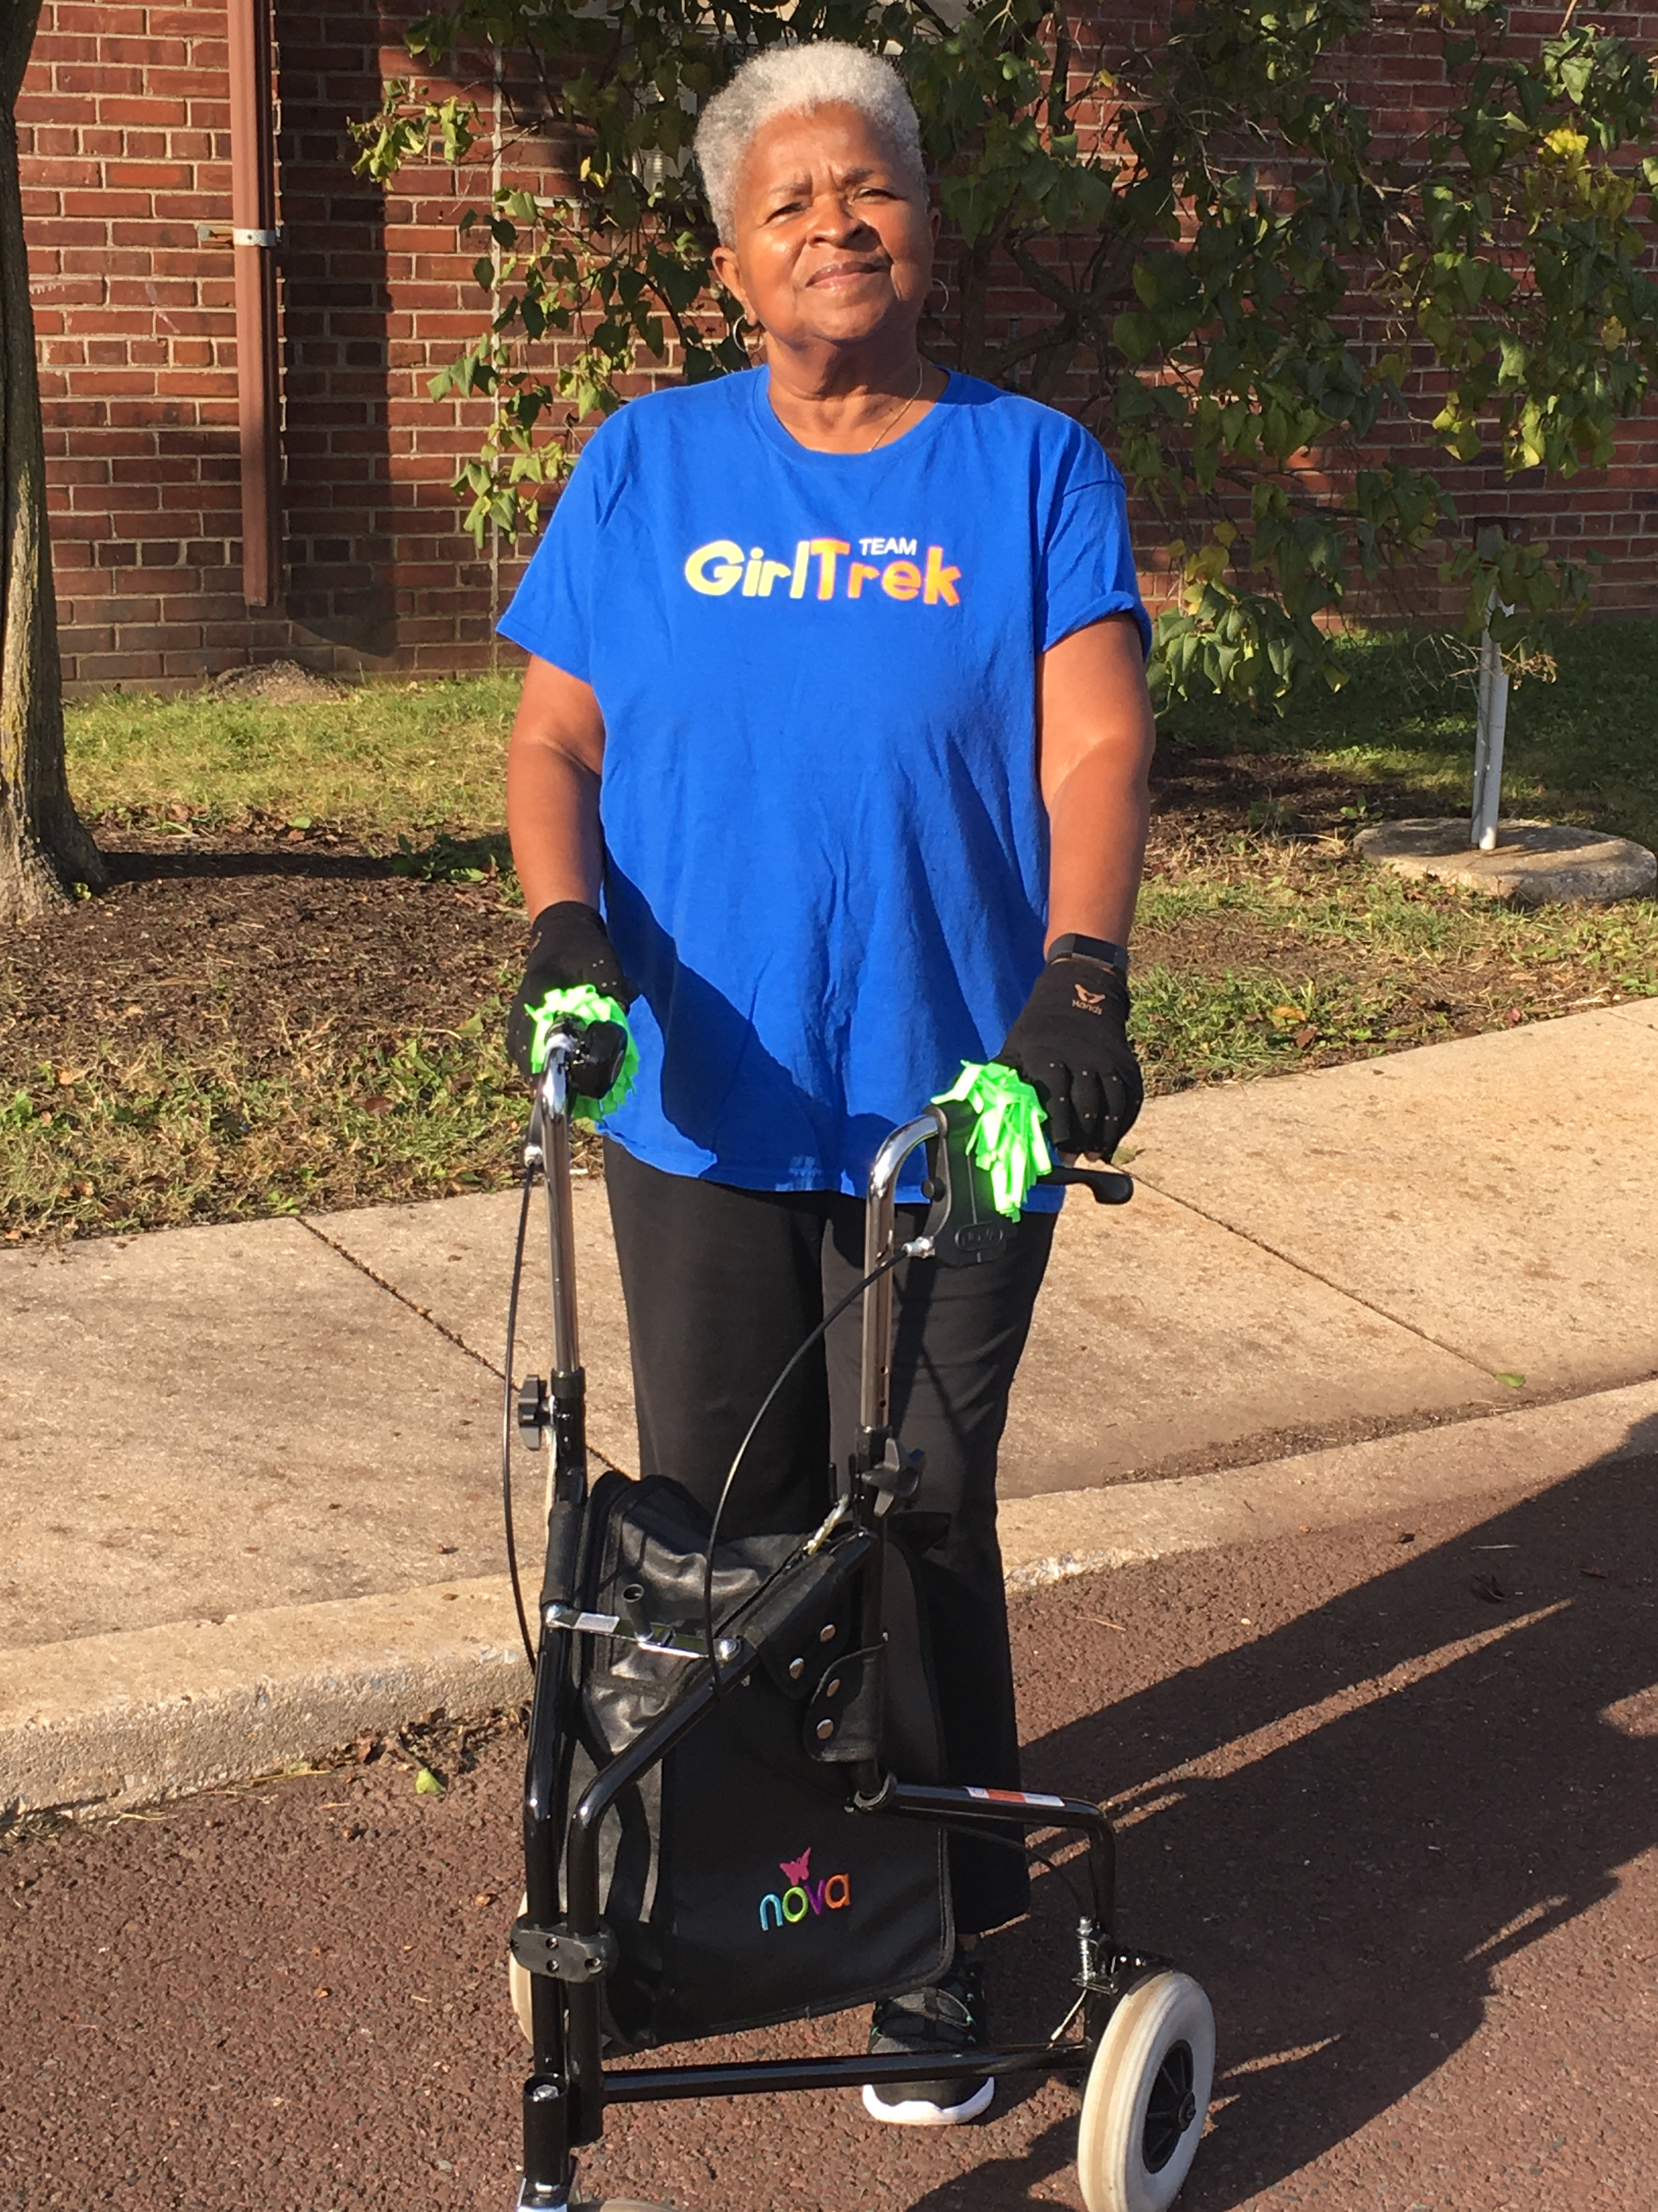
Walk With Ease
Developed by the Thurston Arthritis Research Center and the Institute on Aging of the University of North Carolina, the Walk With Ease Program is the only walking program identified as arthritis-appropriate and evidence-based by the Centers for Disease Control and Prevention. Walk with Ease is offered three times per week for 1 ½ hours for 6-weeks or 18 sessions.
Walk With Ease is for people with arthritis. It is a 5-step walking program proven to:
Reduce the pain and discomfort of arthritis
Increase balance, strength and walking pace
Build confidence in your ability to be physically active, and
Improve your overall health

Slide 10
Want to get involved?
For information regarding
COSA’s Health and Wellness program offerings;
Opportunities to volunteer as program leaders; or
Bring programs to your local community or group, contact:
Ellen Williams at 610-499-1937or e-mail williamse@co.delaware.pa.us

